Slide 1
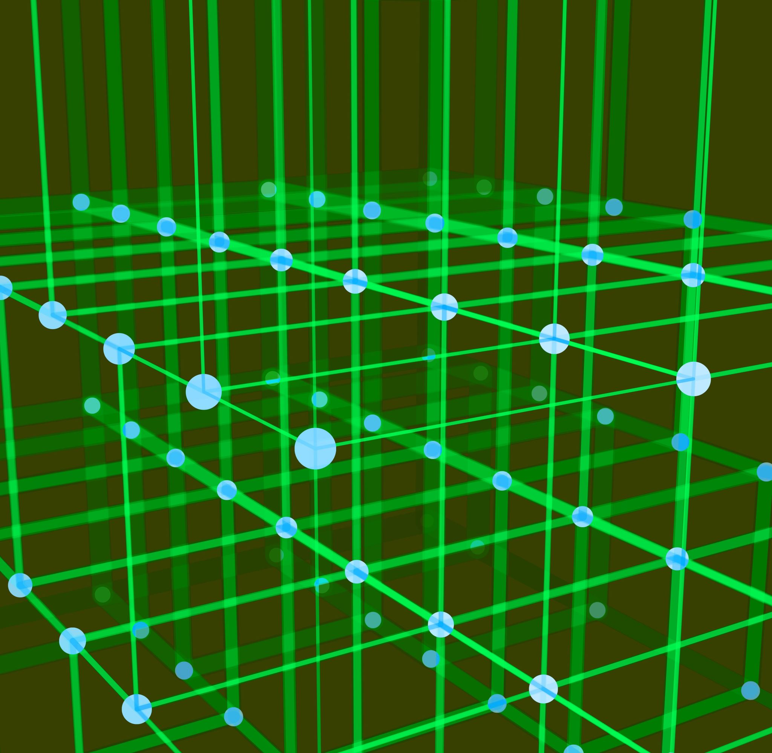
Generative Adversarial Network (GAN)
Sathwik Reddy Chelemela - GAN Model Overview

Slide 2
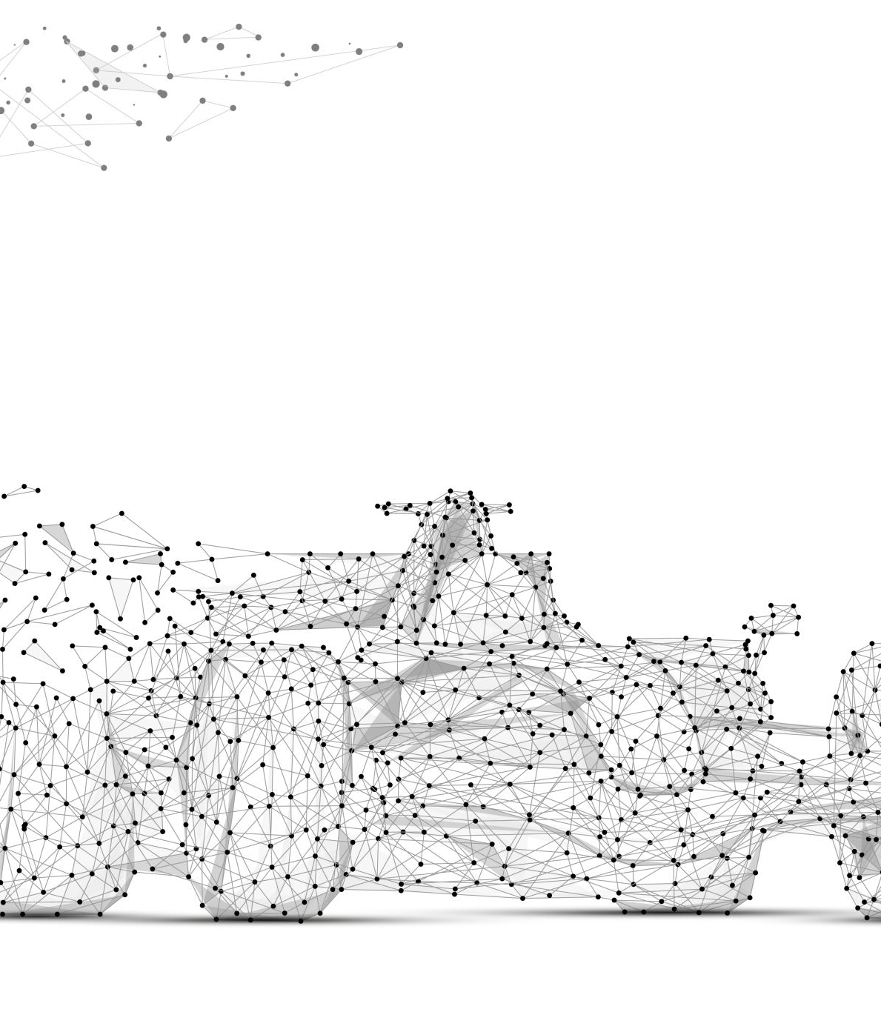
Problem
The problem addressed by the GAN model is generating realistic images, specifically automobile images from the CIFAR-10 dataset.
GANs can help in applications like image synthesis, creative design, and data augmentation.

Slide 3
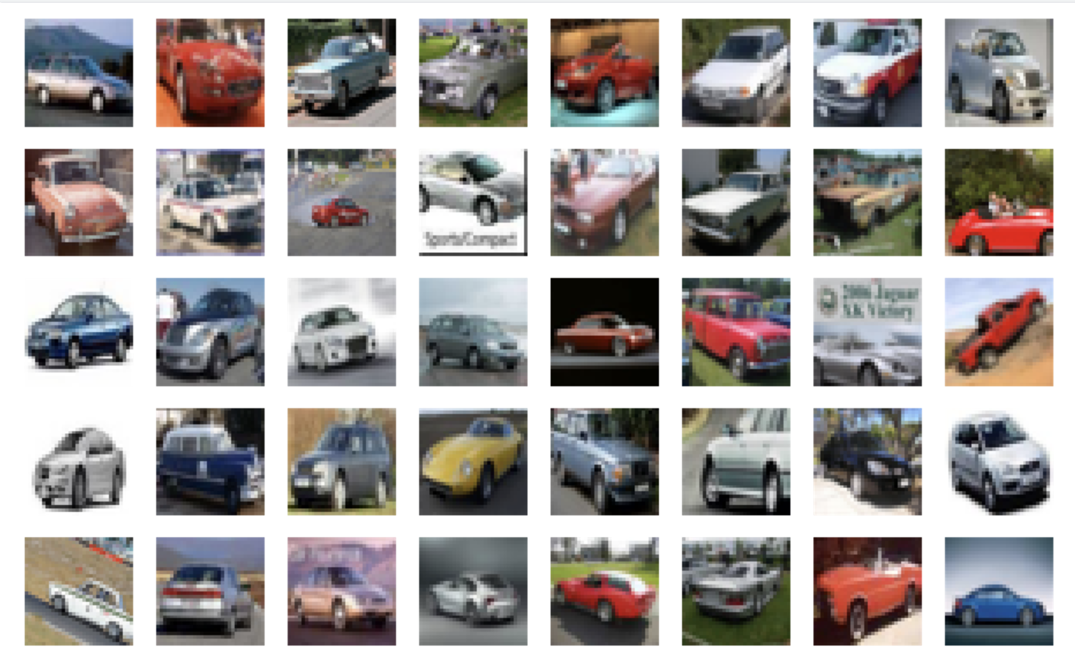
Data and Preparation
Original CIFAR 1
The CIFAR-10 dataset, containing 60,000 32x32 color images across 10 classes, was used.
For this project, the 'automobile' class was selected for training. The dataset was preprocessed, selecting images of automobiles and normalizing them for the GAN model.

Slide 4
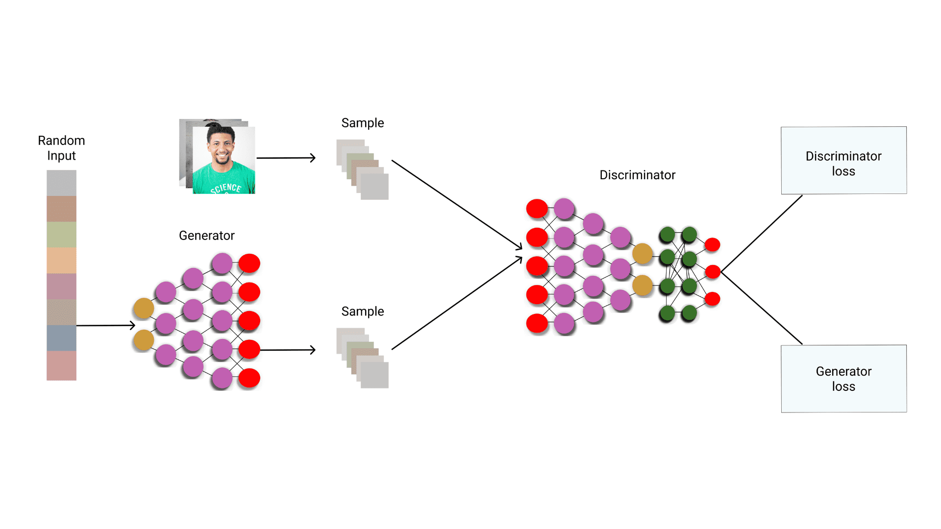
Approach
The GAN model consists of two key components:
1. Generator: Takes a random noise vector (latent space) and generates an image.
2. Discriminator: Distinguishes real images from fake ones and provides feedback to the Generator.
The training process involves a competition between these two networks, improving the quality of generated images over time.

Slide 5
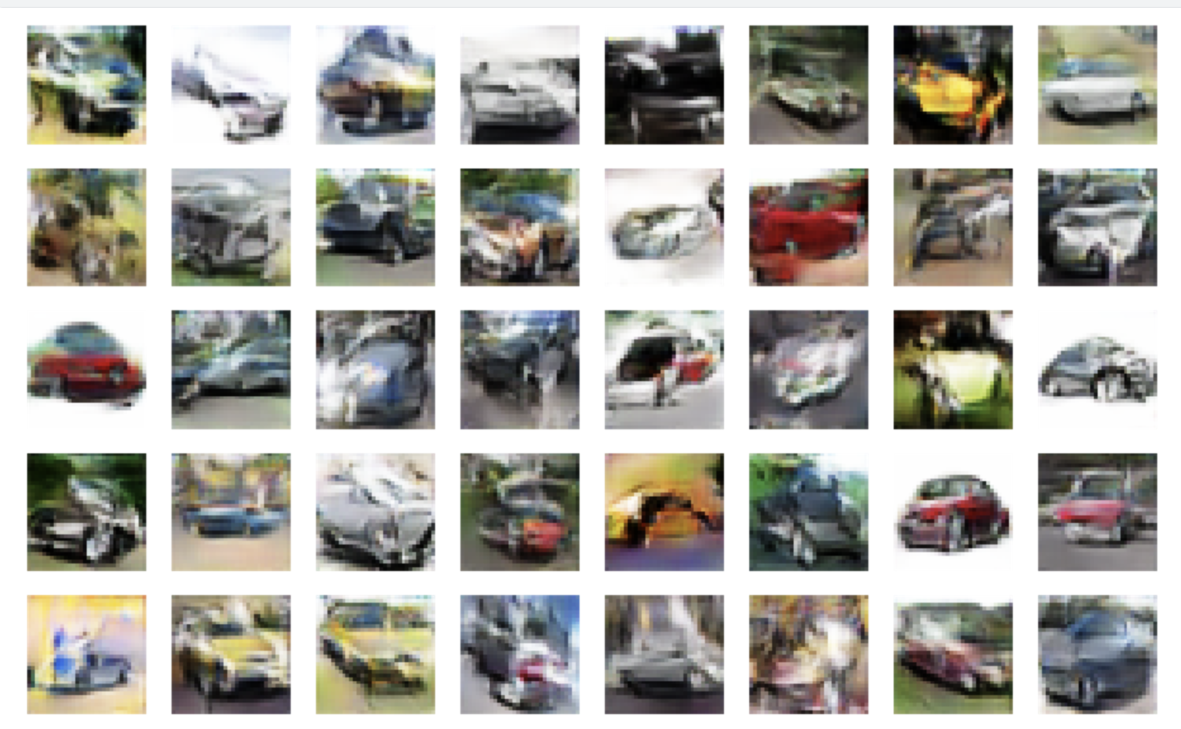
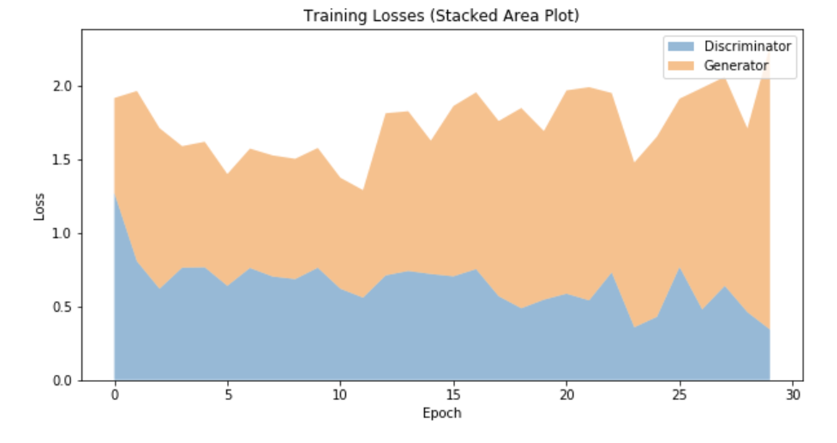
Evaluation
Generated at 30000 epochs
Evaluation is based on both visual inspection and loss function analysis. The Generator and Discriminator losses are monitored during training to ensure stability. Additionally, generated images are compared against real automobile images to assess quality.

Slide 6
Conclusion
With a latent noise vector of 100, the GAN model successfully generated realistic automobile images.
The training process improved the Generator’s ability to produce images indistinguishable from real dataset samples.
This experiment demonstrates the effectiveness of GANs in synthetic image generation and opens doors for further improvements using advanced architectures.

